Slide 1

A Deep Dive into Transformers
Transformers are a powerful type of neural network architecture that has revolutionized natural language processing (NLP), enabling breakthroughs in machine translation, text summarization, and more. This presentation will explore the key concepts of transformers, their evolution, and their applications.

Slide 2

Sequence-to-Sequence (Seq2Seq)
Input
X1
X2
..
Xn
Output
Y1
Y2
..
Yn

Slide 3

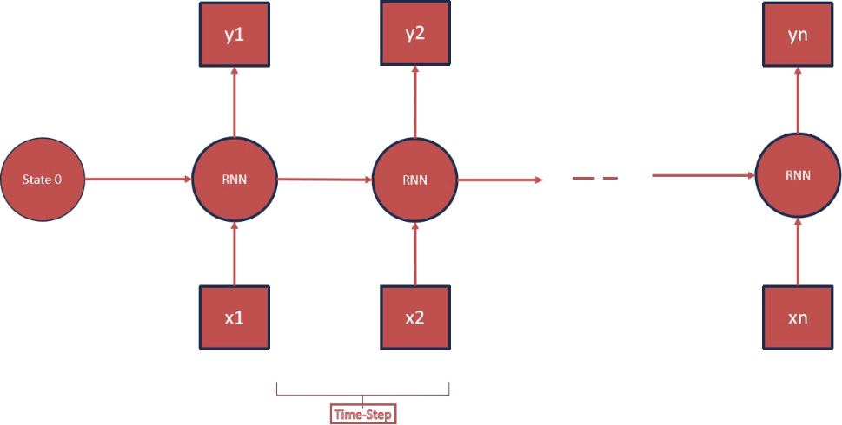

Recurrent Neural Networks (RNNs)

Slide 4


Challenges with RNNs
Long Sequences
Vanishing Gradients
RNNs can struggle to handle long sequences effectively, as computations become increasingly complex and time-consuming.
During training, gradients can vanish, preventing the model from learning long-term dependencies effectively.
Exploding Gradients
Limited Memory
Gradients can also explode, making training unstable and causing the model to learn incorrectly.
RNNs have limited memory capacity, making it challenging for them to capture and maintain information from the beginning of a sequence.

Slide 5

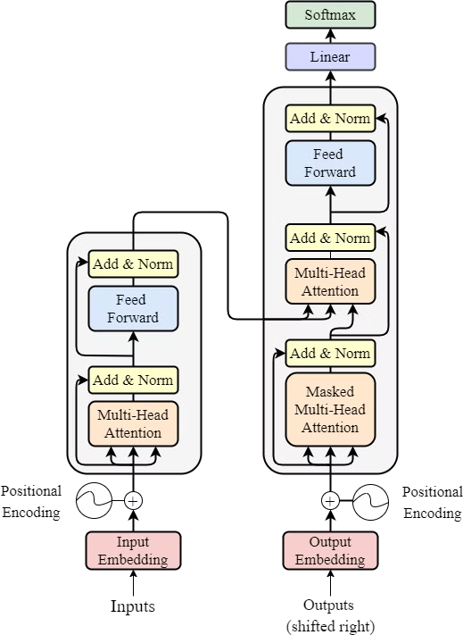

Attention is All You Need
Transformers overcome the limitations of RNNs by employing a novel mechanism called self-attention, which allows them to focus on relevant parts of the input sequence, even across long distances. This breakthrough enables transformers to achieve remarkable performance in NLP tasks.

Slide 6


Tokenizer
Token
Sentence
Hello
Hello ed
ed

Slide 7

Vectors
Patient ID
hello
15
71
16
80
ed
25
92
85
85

Slide 8

Embeddings
Patient ID
Height (CM)
Weight (KG)
Systolic (mmHg)
Diastolic (mmHg)
10200
165
71
120
80
3600
180
92
110
85

Slide 9





Embeddings
Input Tokens
Input IDs
The input sequence is broken down into individual tokens (words or subwords), each representing a distinct unit of meaning.
Each token is assigned a unique ID, allowing the model to process the sequence as a series of numerical values.
Embeddings
Positional Embeddings
Each token ID is mapped to a dense vector representation, capturing its semantic meaning and relationships to other tokens.
Positional information is added to the embeddings, providing the model with the order of tokens in the sequence.

Slide 10
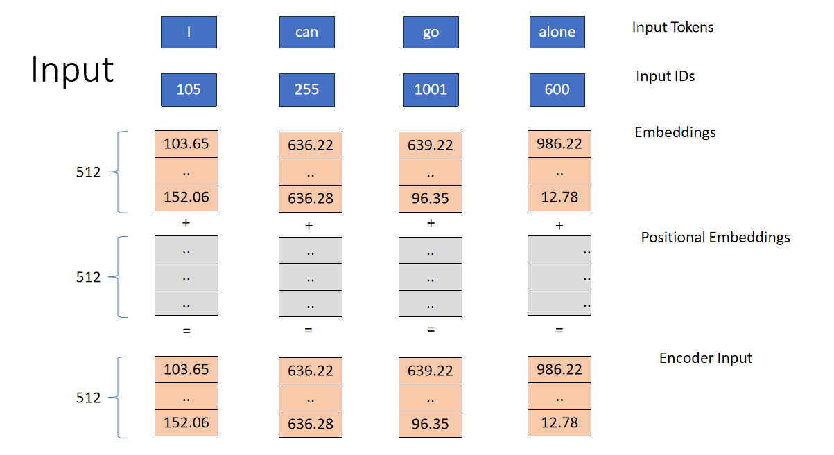


Slide 11






Encoder Input
1
Tokens
2
Input IDs
3
Embeddings
4
Positional Embeddings
5
Encoder Input

Slide 12

Self-Attention: The Key Mechanism
1
1. Query, Key, and Value
2
2. Scoring Relevance
The input embeddings are transformed into three separate vectors: query (Q), key (K), and value (V).
The query vector for each token is compared to the key vectors for all tokens in the sequence, calculating a score representing their relevance.
3
3. Softmax Normalization
4
4. Weighted Summation
The scores are normalized using the softmax function, creating a probability distribution that represents the attention weights.
The value vectors are multiplied by the attention weights, and the weighted sum is computed, generating the self-attention output.

Slide 13
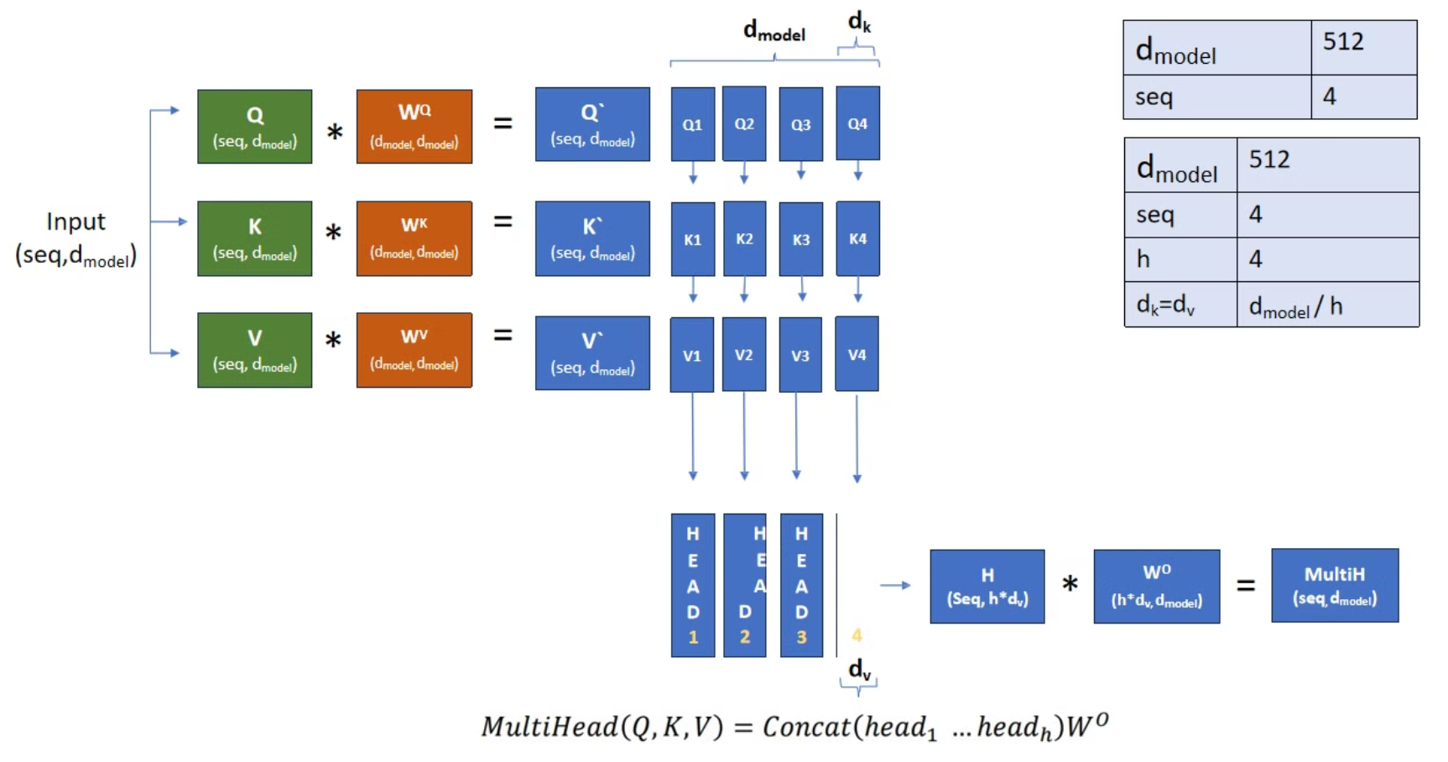

Multi-Head Attention: Enhancing the Model

Slide 14
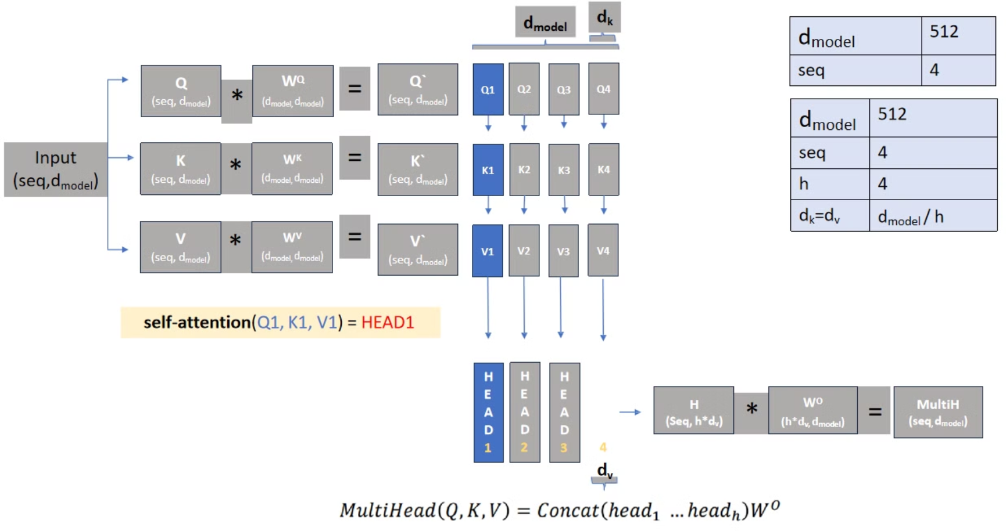


Multi-Head Attention:

Slide 15
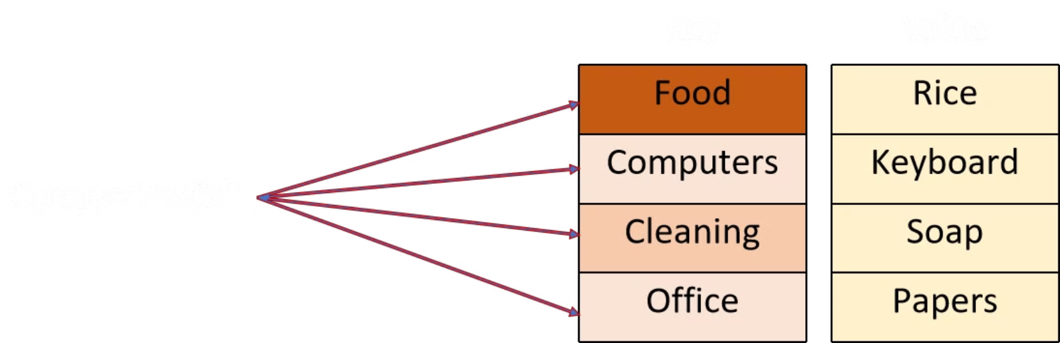

Query, Key & Value

Slide 16

Masked Attention
Masked Attention is a specialized form of self-attention used in Transformer models, particularly in tasks like text generation. It ensures that the model processes sequences in a way that prevents it from "cheating" by looking at future tokens during training.
How Masked Attention Works
Masking the Future
Preserving Causality
Application in Training
Example
If the input sequence is: I can go alone

Slide 17
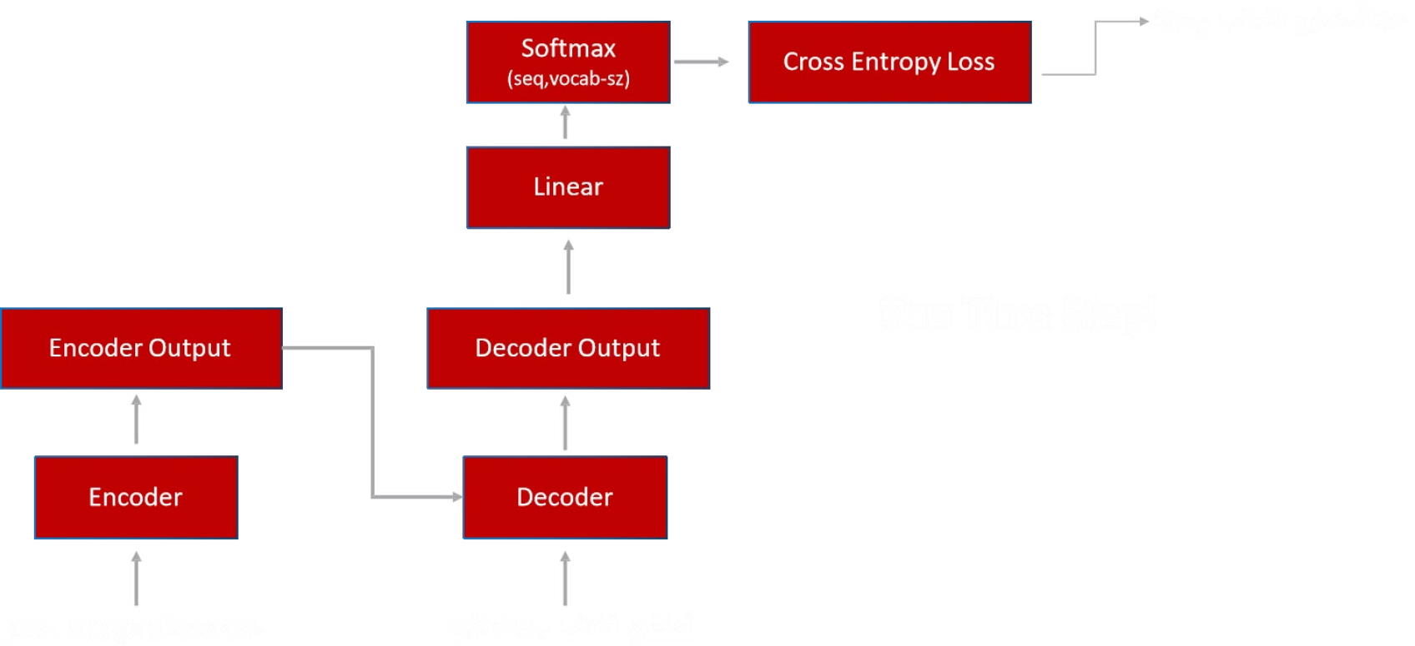
Training

Slide 18

Introduction to M2M-100
M2M-100: A cutting-edge multilingual translation model developed by Facebook. Supports 100 languages directly, removing the need for English as a bridge language, offering improved accuracy and real-time communication across languages.

Slide 19

Understanding M2M-100
Direct Translation
Global Communication
M2M-100 enables seamless translation between 100 languages without relying on English as an intermediary.
It ensures fast and accurate translations, connecting diverse linguistic communities worldwide.

Slide 20
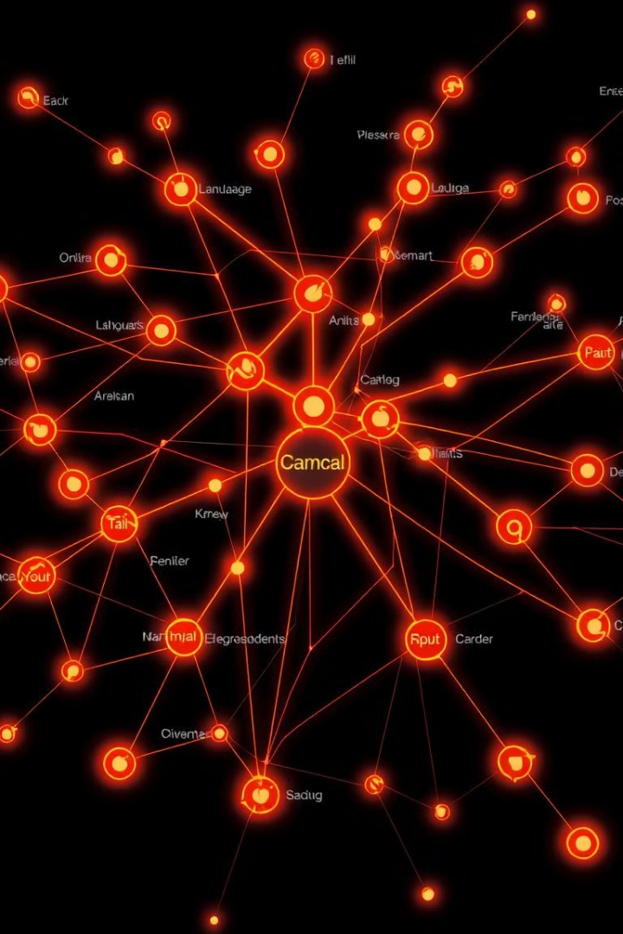

Core Features of M2M-100
1
Direct Translation
2
High Accuracy
Translates between any two supported languages without English.
Ensures high accuracy, especially for non-English language pairs.

Slide 21
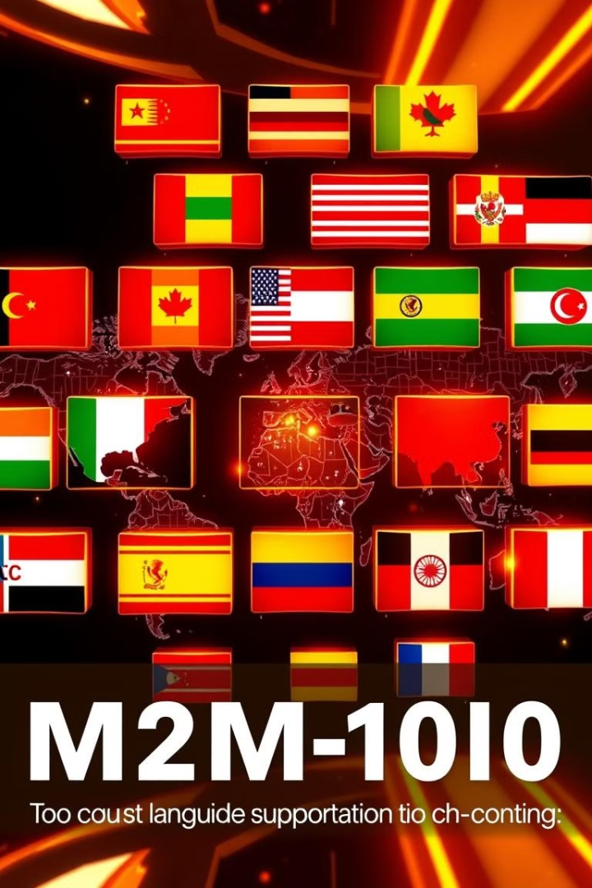



Core Features of M2M-100 (cont.)
Wide Language Support
Open-Source
Supports over 100 languages, including low-resource languages.
Enables developers to customize and improve the model.

Slide 22



Training Method Comparison: M2M-100 vs. English-Centric Models
1
English-Centric
2
M2M-100

Slide 23
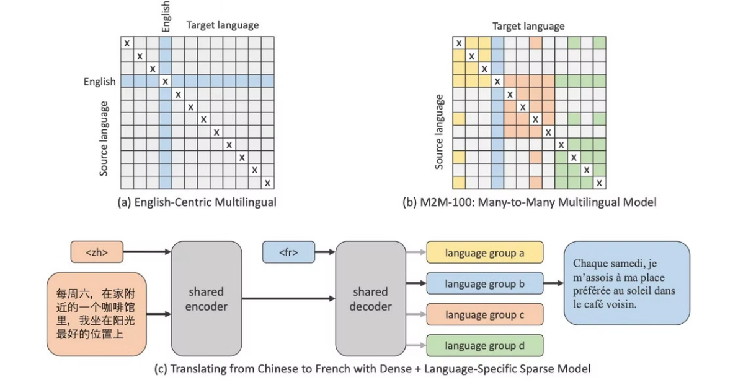

Training Method Comparison: M2M-100 vs. English-Centric Models (cont.)
1
English-Centric
Trained primarily on pairs involving English.
2
M2M-100
Trained on direct language pairs, focusing on relationships between all languages.

Slide 24
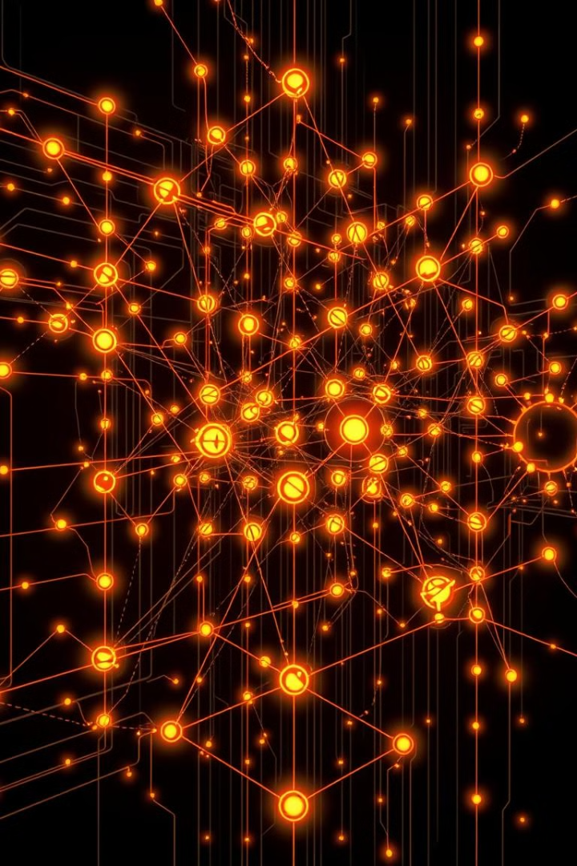


Some techniques
1
Mixture-of-Experts
2
Data Mining
3
Backtranslation

Slide 25


Notes:
Translate

Slide 26

Toxicity Detection Model

Slide 27

Toxicity Detection Model: A Deep Learning Approach
Deep Neural Networks
Applications
The toxicity detection model is a deep neural network designed to detect harmful, abusive, or toxic text.
Applications include social media platforms, forums, and more.

Slide 28
Toxicity Classification Labels
Basic Toxic
Severe Toxic
Threat
This label designates mildly harmful language, potentially offensive or inappropriate but not explicitly violent or hateful.
This label signifies strongly harmful language, likely causing significant distress or harm to the recipient.
This label identifies language that directly threatens physical harm or violence towards an individual or group.
Racist
This label indicates language that is prejudiced, discriminatory, or hateful towards individuals or groups based on their race or ethnicity.

Slide 29

Data Collection and Model Training
1
1. Data Collection
2
2. Label Annotation
A vast and diverse dataset is collected, encompassing both toxic and non-toxic text examples.
Each text example is carefully labeled by human annotators, providing the model with ground truth for learning.
3
3. Model Training
The model is trained on the labeled dataset, enabling it to learn patterns and identify toxic language.

Slide 30
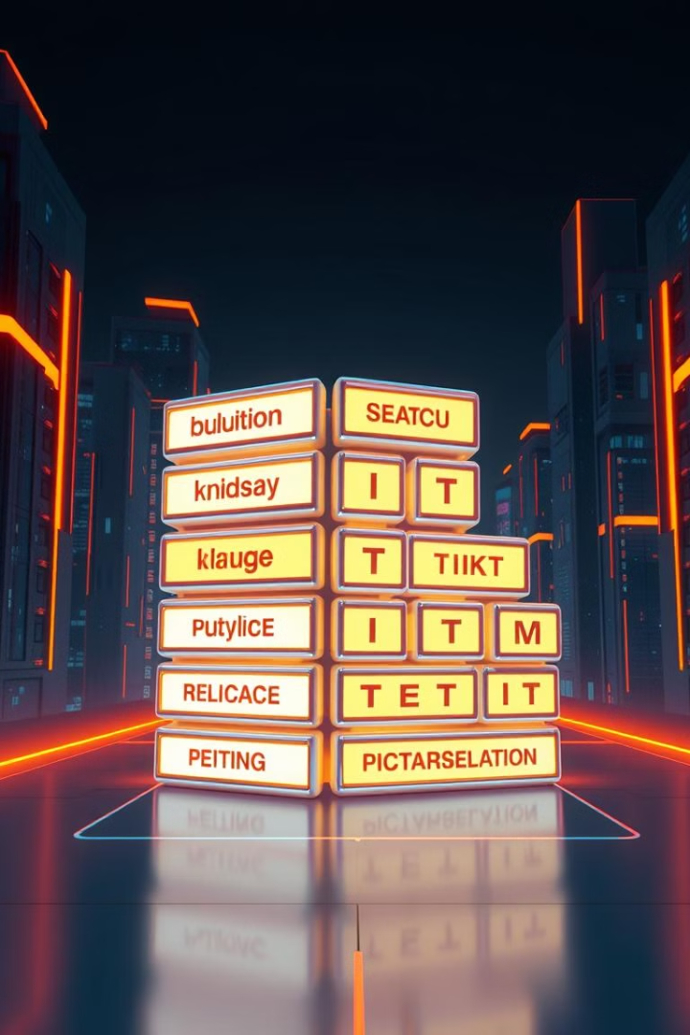



Tokenization Process: Breaking Down Text
Tokenization
Input text is transformed into smaller units called tokens, such as words or subwords.
Structure
This process provides structure to the text, making it suitable for model processing.
Understanding
Tokenization helps the model understand the meaning and context of words in the text.

Slide 31


Illustrative Example: Tokenization and Labels
INPUT
LABELS
I hate you
[1, 0, 0, 0]
I love you
[0, 0, 0, 0]
You suck, I'm coming for you
[0, 1, 1, 0]

Slide 32

Tokenization and Vectorization
1
Tokens
The input text is broken down into tokens.
2
Vectors
Each token is converted into a numerical vector, representing its meaning.

Slide 33

TOKENS
i hate you
[ 42 , 8 , 56 ]
[0.1] [0.8] [0.8]
[0.2] [0.7] [0.1]
[0.7] [0.2] [0.1]
[0.0] [0.1] [0.5]
i love you
you suck, i’m coming for you

Slide 34




Vectorization with Keras
Keras
1
The Keras library is used to convert tokens into numerical vectors.
Vector Representation
2
Each token's meaning is represented in a high-dimensional space.

Slide 35

Model Training and Saving
1
Training
The model is trained on the labeled dataset, learning to identify toxic language patterns.
2
Saving
The trained model is saved as an H5 file, storing its parameters and weights.
3
Reuse
This saved model can be easily loaded and used for future toxicity detection tasks.

Slide 36

Using GridUApp for Output
GridUApp provides a user-friendly interface for deploying ML models.
Users can upload the H5 file, input text, and receive predictions in a clean interface.

Slide 37

Notes:
Toxic

Slide 38

facebook/bart-large-cnn: Deep Dive into Text Summarization

Slide 39

What is facebook/bart-large-cnn?
Transformer-Based
Text Processing
A transformer-based model designed for generating concise, coherent text summaries.
Leverages the strengths of the Transformer architecture for effective text processing and understanding.

Slide 40

Fine-Tuning and Training
1
Extractive Summarization
2
Abstractive Summarization
Identifies and extracts important sentences from the source text.
Paraphrases and synthesizes key ideas, going beyond sentence extraction.
3
Pre-Training
Utilizes a denoising objective to enhance text understanding and robustness.

Slide 41
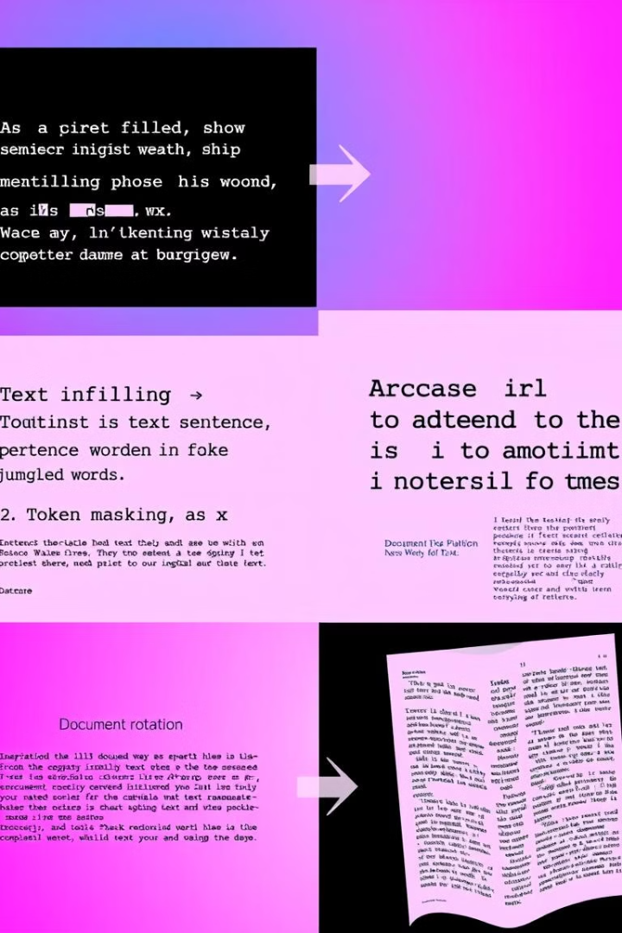


Corrupting Text for Robustness
Text Infilling
Sentence Permutation
Random spans of text are removed and replaced with a \[MASK\] token.
Sentences are shuffled in random order.
Token Masking
Token Deletion
Random individual tokens are replaced with \[MASK\].
Random tokens are completely deleted from the text.

Slide 42




Encoder-Decoder Architecture
Encoder
Processes input text and extracts key information.
Decoder
Generates a concise summary based on encoded information.

Slide 43






Advantages of facebook/bart-large-cnn
High Accuracy
Pre-trained
Fine-Tuned
Produces summaries that are remarkably close to human-written summaries.
Requires minimal fine-tuning for specific tasks.
Can be further fine-tuned for specific domains and applications.

Slide 44




Real-World Applications
News Summarization
1
Generating short summaries of news articles.
Document Summarization
2
Creating concise overviews of research papers, legal documents, or lengthy reports.
Customer Feedback Analysis
3
Summarizing customer feedback to identify key themes and trends.

Slide 45


The Future of Summarization
Multi-Document Summarization
1
Summarizing information from multiple documents on the same topic.
Abstractive Summarization
2
Generating summaries that paraphrase and synthesize key points, going beyond simply extracting sentences.
Integration with Other Technologies
3
Combining facebook/bart-large-cnn with other AI technologies for enhanced understanding and knowledge extraction.

Slide 46

Notes:
Summarization

